Slide 1
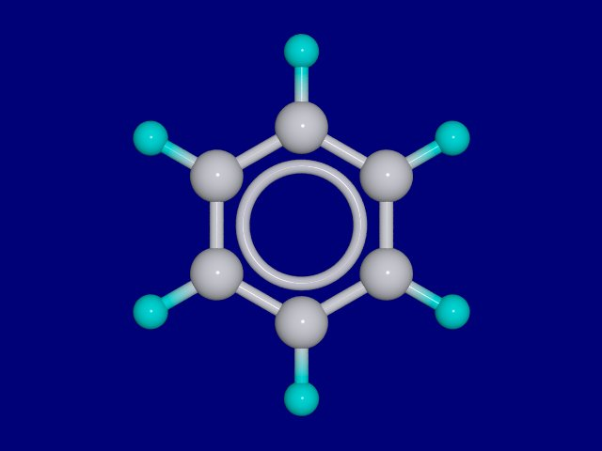
Aromatic Compounds
Aromatic Compouds
Those chemicals which contain one or more benzene ring

Slide 2
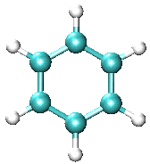
Early analysis showed that benzene was cyclic and had the formula C₆H₆. This meant a shortfall of carbon bonds.

Slide 3
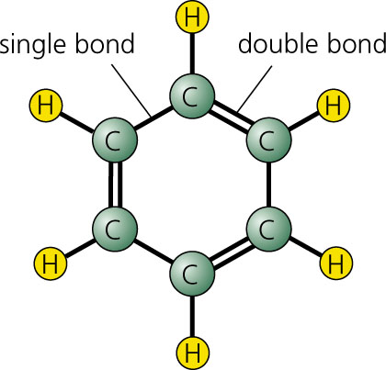
Kekule proposed that the benzene ring consisted of 3 double & 3 single carbon bonds and..

Slide 4
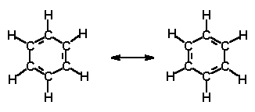
…also the proposal of bond oscillation. This, however suggested a high degree of unsaturation… but benzene did not readily undergo addition reactions such as halogenation.

Slide 5
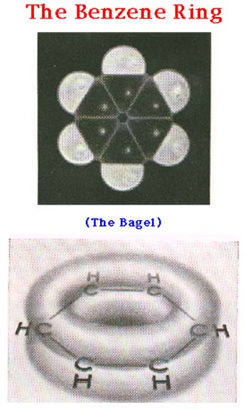
The equal bond lengths were found to be intermediate in size to those of a single or double bond.
This lead to the idea of the fourth electron of each carbon being delocalised forming two donut shaped regions containing a total of six electrons.

Slide 6
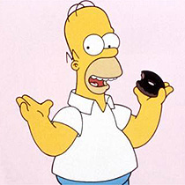
“Donuts – is there anything they cant do?”
Homer Simpson, 1995

Slide 7
Yet another benzene representation

Slide 8
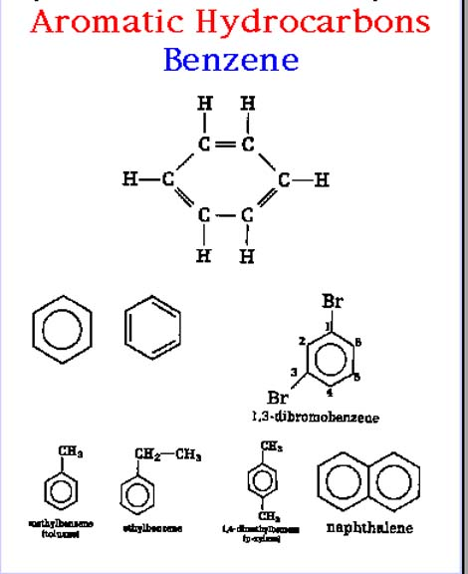

Slide 9
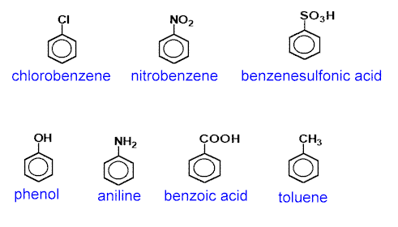

Slide 10
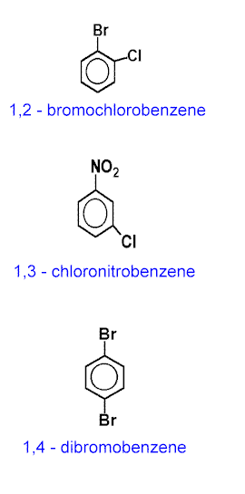

Slide 11
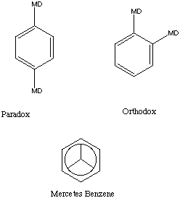

Paralytic
Lesser known aromatic compounds

Slide 12
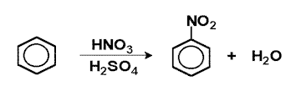
REACTIONS OF AROMATIC HYDROCARBONS
Nitration

Slide 13

Alkylation

Slide 14
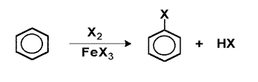
Halogenation

